Slide 1
Arabic Dialect Identification
By : Youssef Kamil Adly

Slide 2
Content
Data pre-processing
Model architecture
Evaluation metrics
Results

Slide 3
Data pre-processing
I have used two different Pre-processing approaches
Second approach | First approach
Remove Emojis Remove punctuations Remove mentions & hashtags Normalize some characters to reduce spelling mistakes ex : (إأٱآا to ا ) Remove English characters Remove Hindi numbers Remove “tatweel”.ex : ( مـــصر to مصر) Remove Tashkel . ex (مِصْرُ to مصر) Farasa Segmentation | Remove Emojis Remove punctuations Remove mentions & hashtags Normalize some characters to reduce spelling mistakes ex : (إأٱآا to ا ) Remove English characters Remove Hindi numbers

Slide 4
Data pre-processing
I haven’t removed stop words or most common words, I think that will reduce the accuracy because every dialect use some stop words that the others don’t use, and that helps the models to distinguish the dialects
I have used QADI test set as a benchmark, made sure to remove this test data from fetched data-set

Slide 5
Model architecture
ML models
I have tried different architecture and techniques like pre-trained Mazajak embedding, CountVectorizerand and TFIDF with different Models like Logistic regression, SVM, SGD and Naïve bayes
The best result I have got was with Coubtvectorizer and Logistic Regression
I have used ngram_range=(1,2), max_features=1700000 due to the limitation of the environment Ram
SVM was taking too long time to be fitted so I didn’t deal with it

Slide 6

Model architecture
DL models
I used AraBERTv2 through Keras and Pytorch with 76 max length of tweet which is 99% of data to reduce the training time
I used Class_weight to deal with Imbalanced data but didn’t affect too much

Slide 7
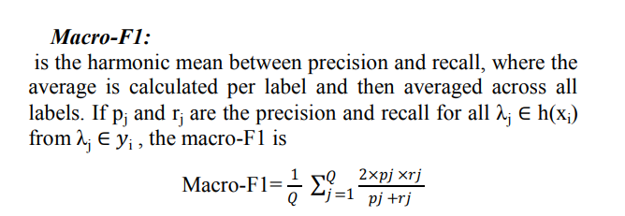
Evaluation metrics
macro-averaged F1-score

Slide 8
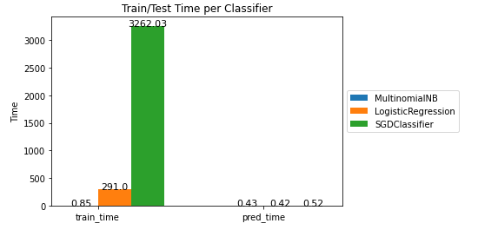

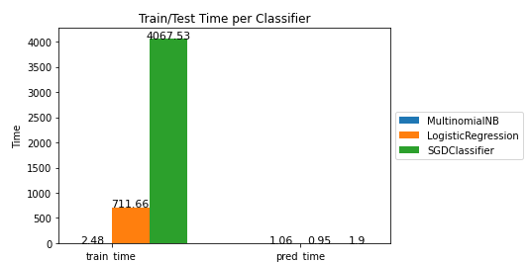
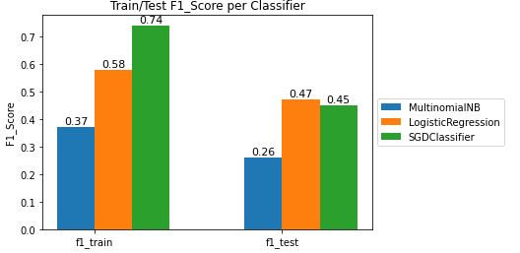
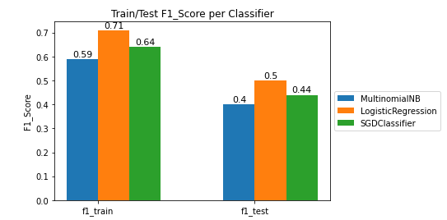
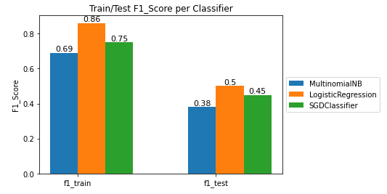
Results
ML models
TFIDF
ngram_range = (1, 1)
ConutVectorizer
ngram_range = (1, 1)
ConutVectorizer
ngram_range = (1, 2) max_features=1,500,000
best result with respect to time was Logistic Regression with ConutVectorizer ngram_range = (1, 1) : 50%

Slide 9
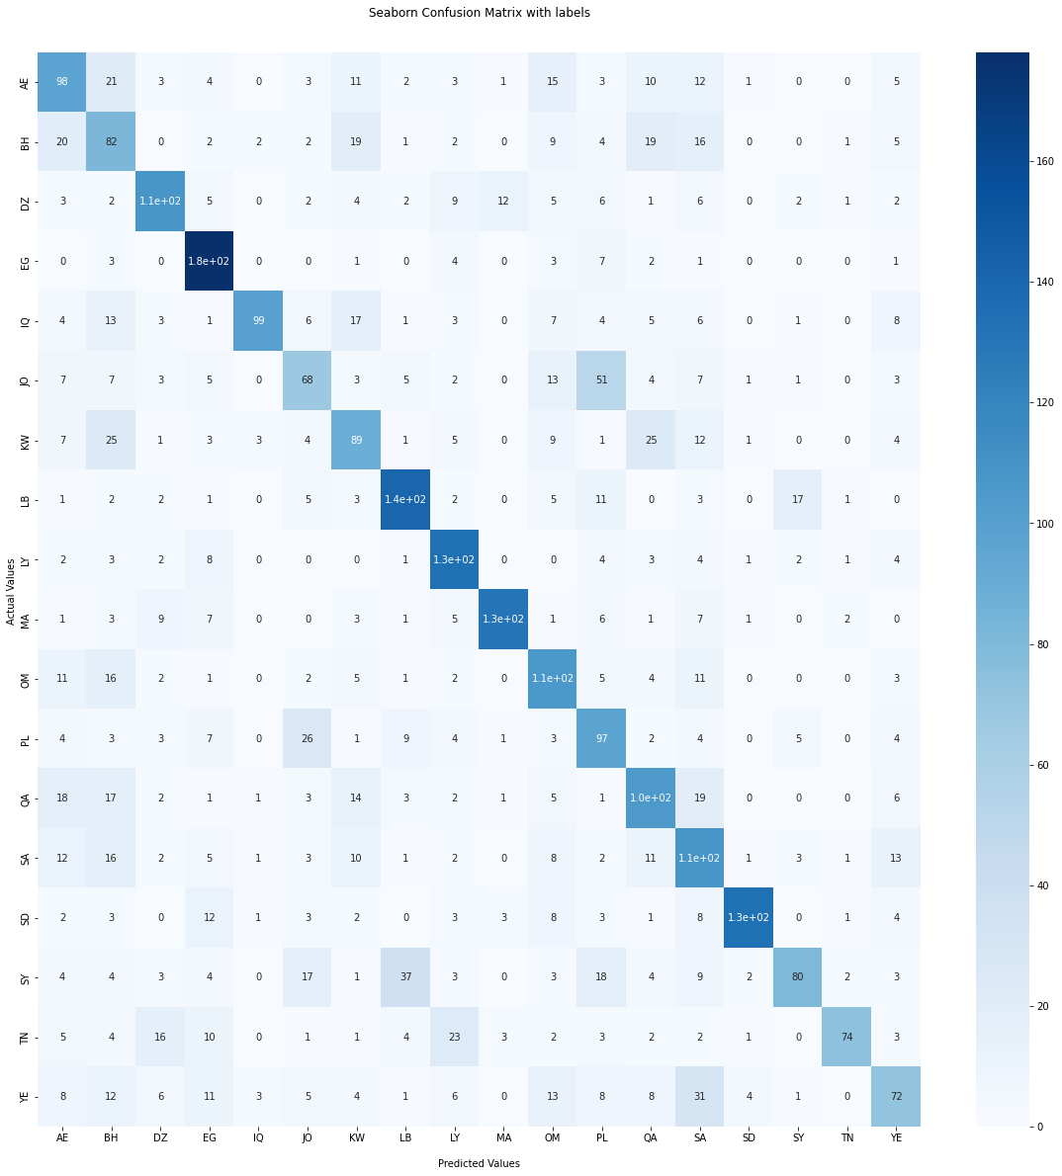
Results
DL model
AraBERTv2-base with Ktrain
58% on QADI Test-Set

Slide 10
Results
Some Notes :
The Accuracy maybe increases with AraBERTv2-large
The highest error is between ( PL & JO ) classes which makes sense
Dealing with Mazajak embedding needs bigger Ram, so it didn’t work well with me
The longer a tweet, the more accurate the prediction was
The time was the most critical thing to me to try different models and different pre-processing techniques (1 epoch takes almost 3 hours training)

Slide 11
Thank you

